Slide 1
Stage: Validation
34 locations
482 locations
117 extracted traffic count
72 to be validated

Slide 2
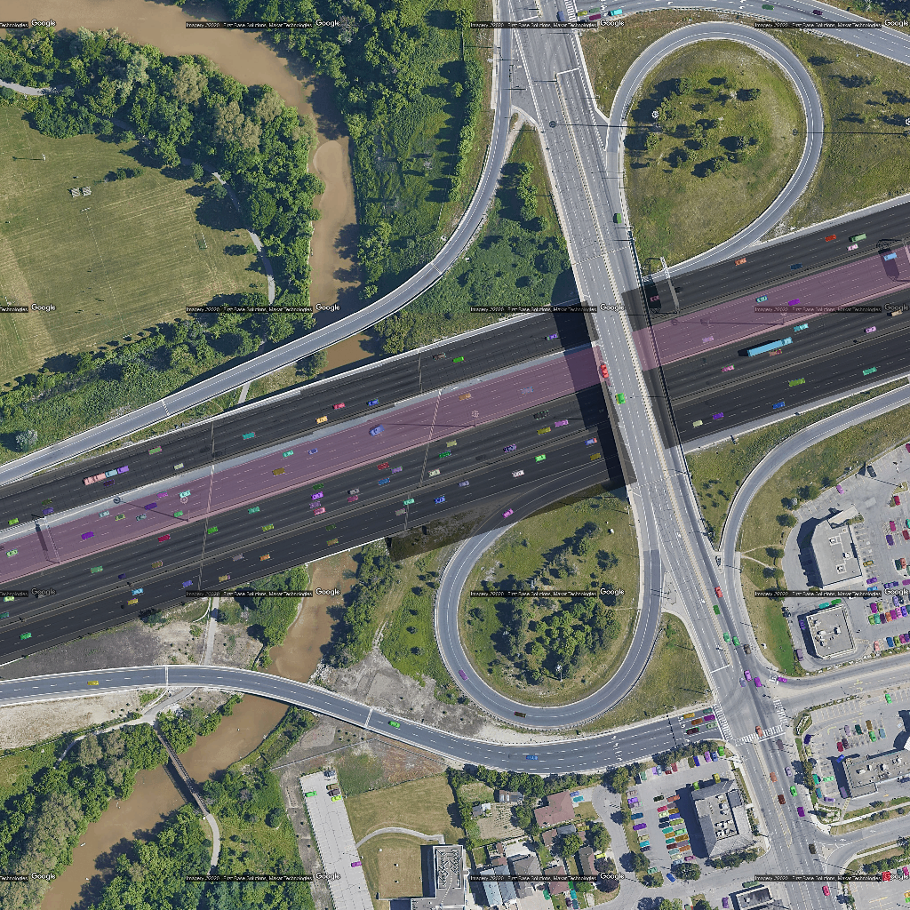
TODO 1:

Slide 3
TODO 2:

Slide 4
BQNA:
Data collection
Data cleaning and aggregation
Video processing
Moving observing

